Slide 2
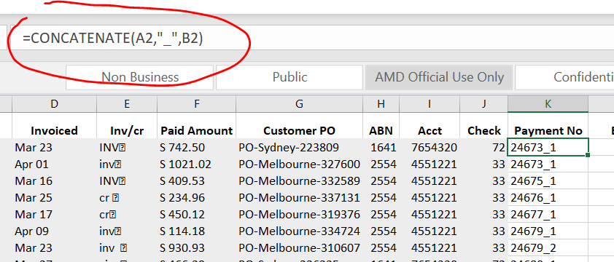
Concatenate function (joins text together)
Concatenate 2 cell strings with “_”:

Slide 3
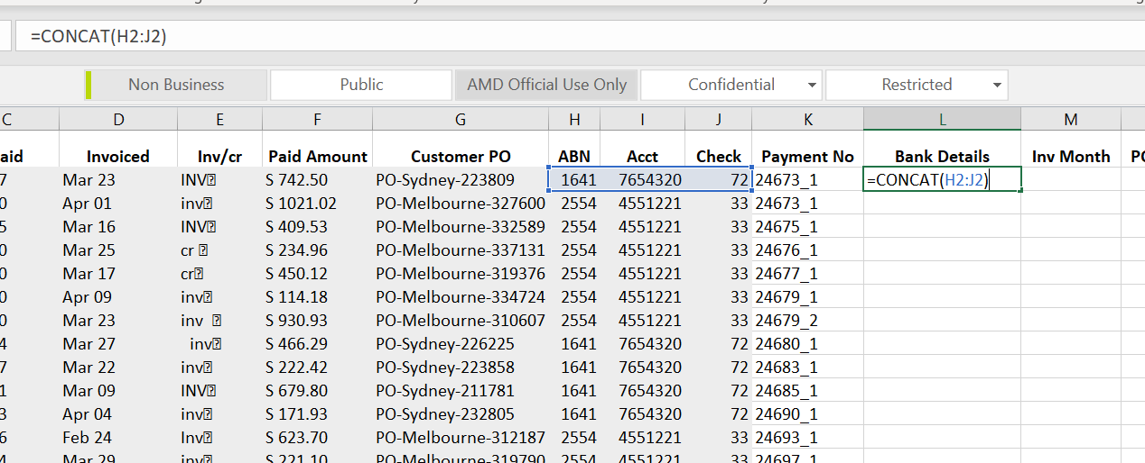
Concat Operator (concate ajacent elements)

Slide 4
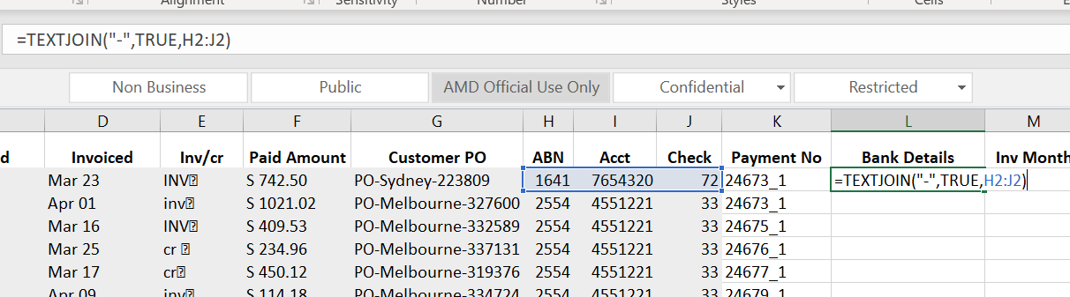
TEXTJOIN (advanced options in combing cells)

Slide 5
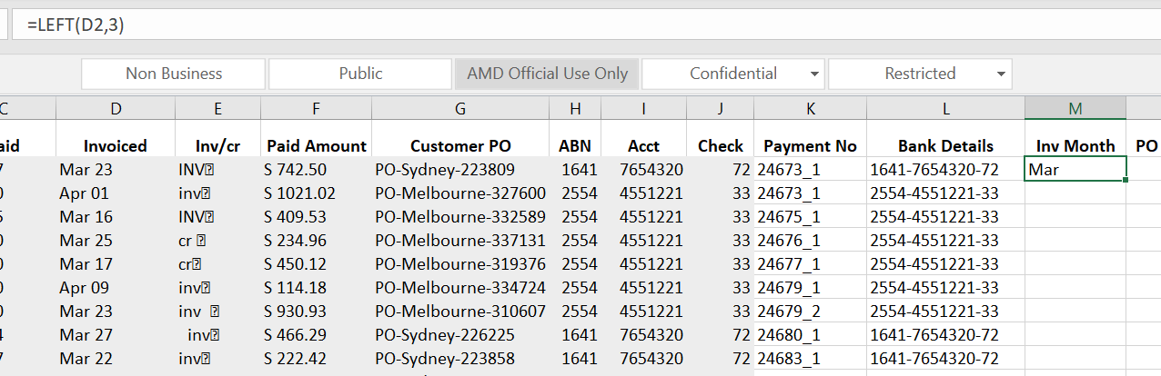
LEFT(Returns the leftmost characters from a text value)
It only work if the target is text format not date format

Slide 6
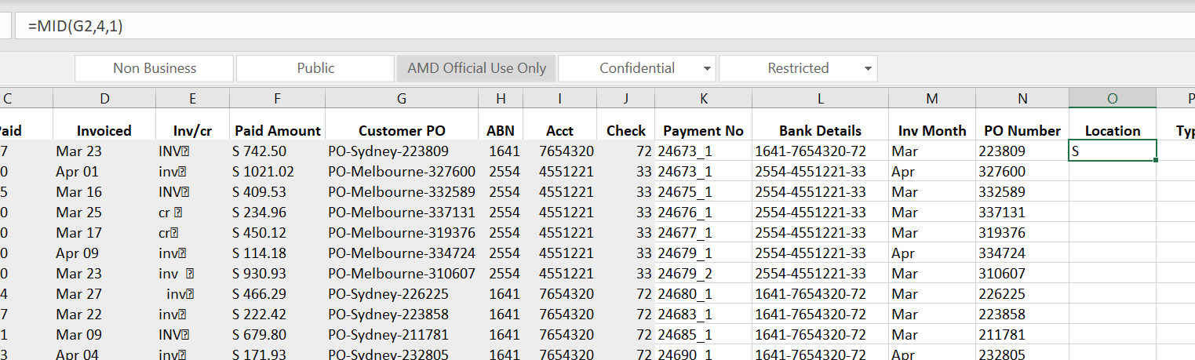
MID(returns a specific number of characters starting at a specifiedposition)

Slide 7
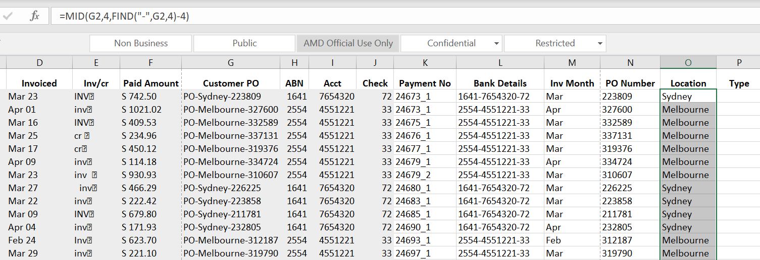
Find (find one text value within another text value)

Slide 8
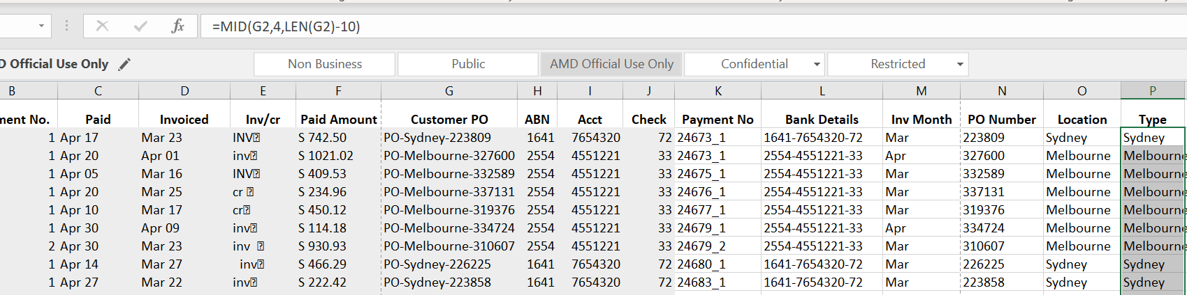
LEN (Return the number of characters in a text string)

Slide 9
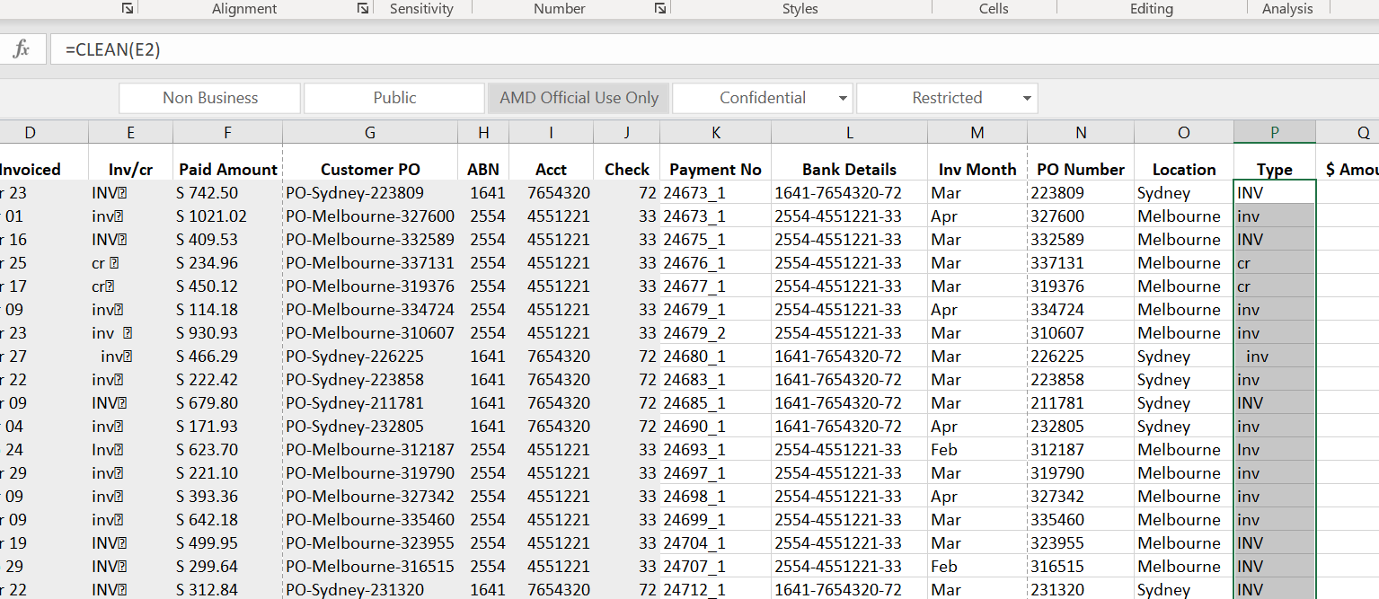
Clean (strips non-printable characters from text)

Slide 10
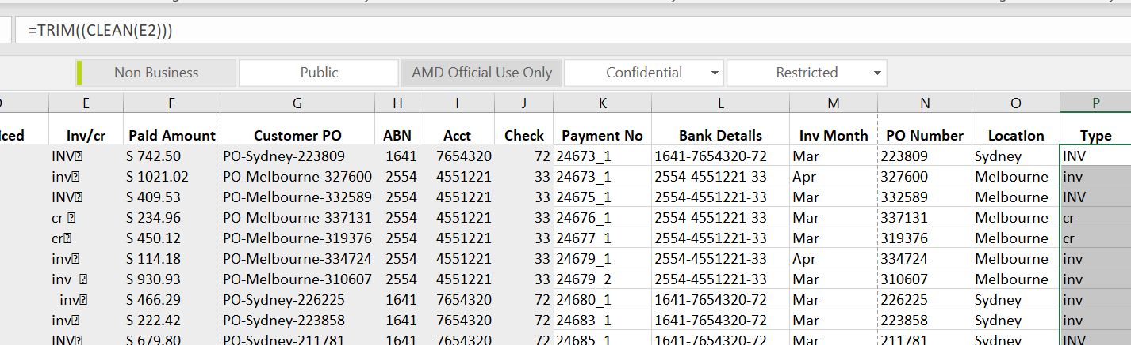
Trim (removes extra spaces from text)

Slide 11
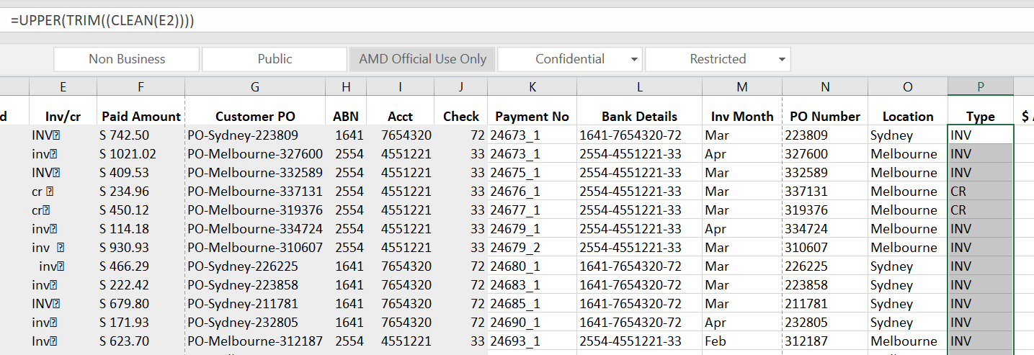
Change case
UPPER
LOWER
PROPER(Capitalizes only the first letter of each word)

Slide 12
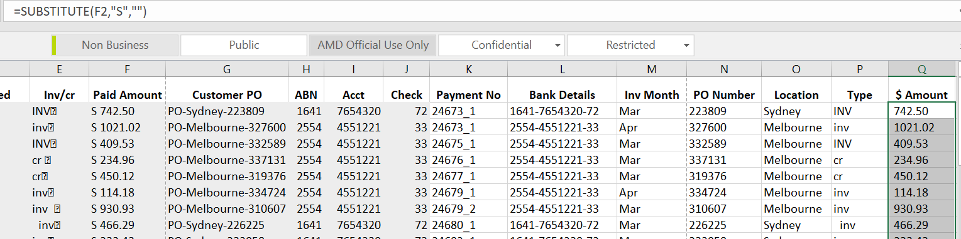
Substitute
Replace text based on content

Slide 13
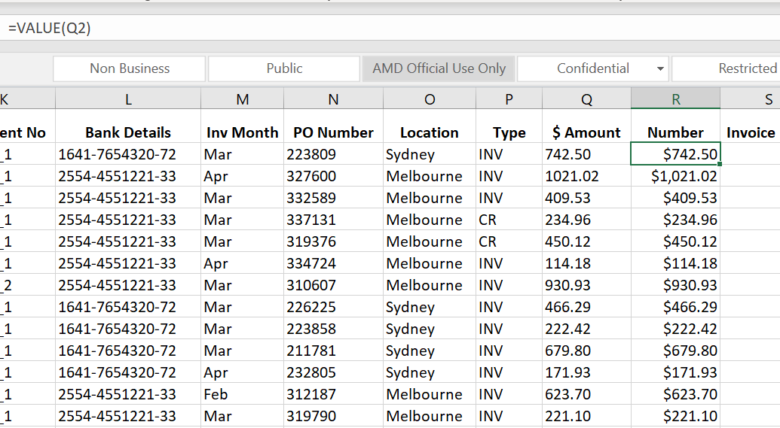
Value (convert text to a numerical value)

Slide 14
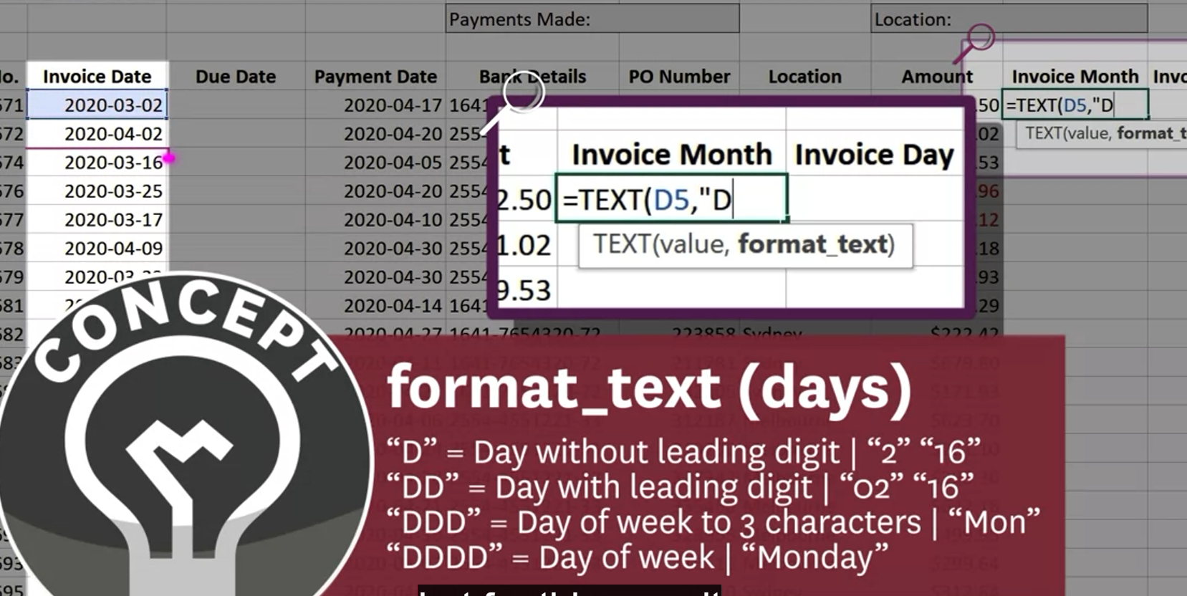
Text(convert and return date as plain text)

Slide 15
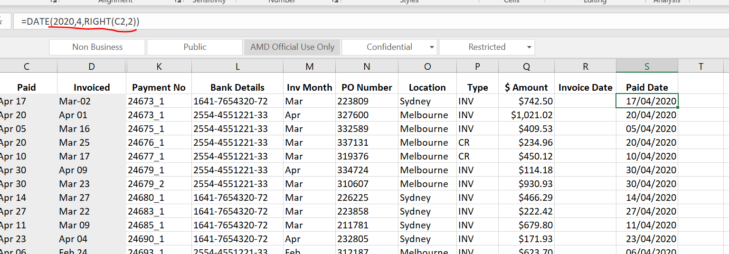
Date (convert text to date)
Must be all numbers
Extract C2 date information

Slide 16
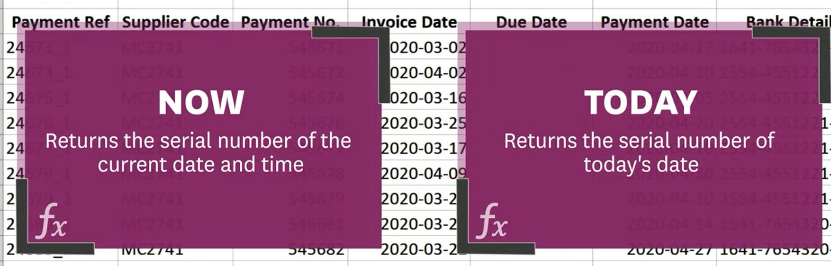
Now & TODAY function

Slide 17
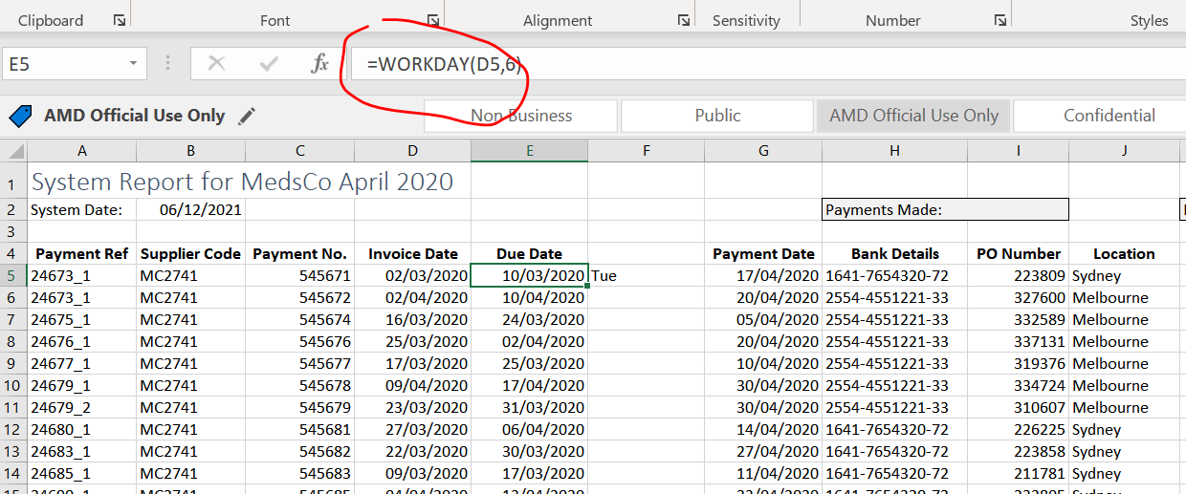
WORKDAY
6 workdays after particular date (assume sat/sun are non-working days)

Slide 18
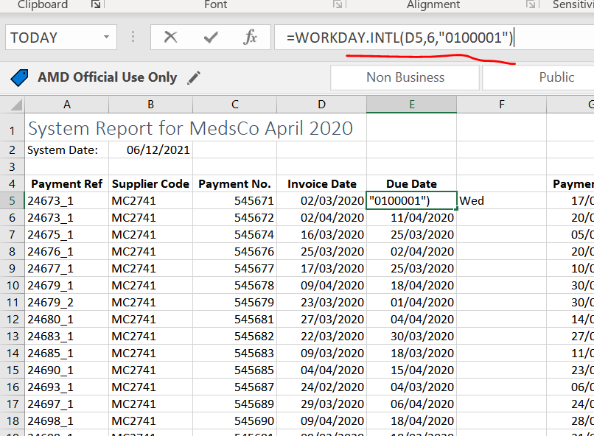
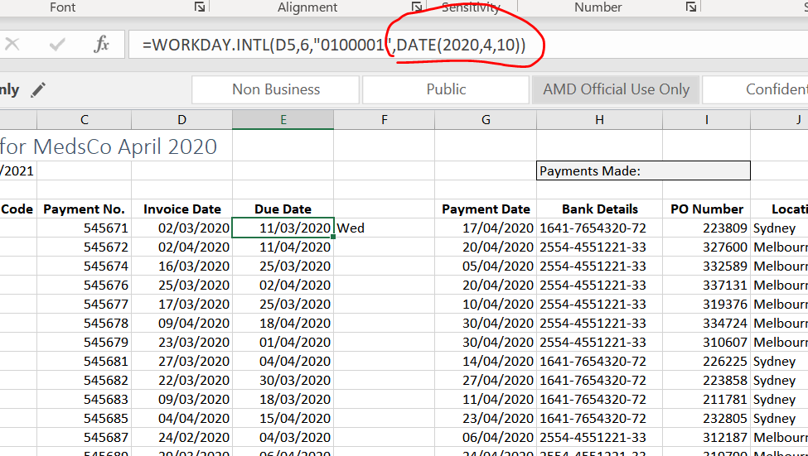
Workday.intl
6 workdays after (assume Tue/Sun are non-working days, so put “1”, the rest days put “0”)
If we want to take into a account of holiday(eg, April 10)

Slide 19
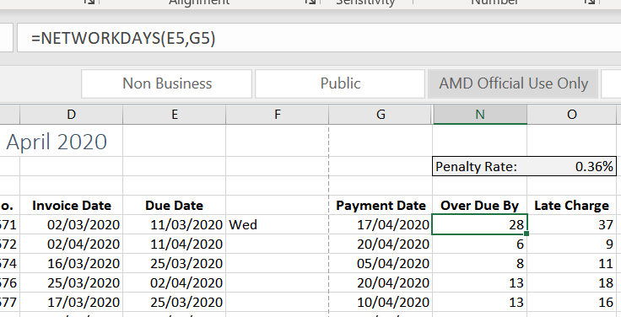
Networkdays (return the number of whole working days between a start/end date)
Assume sat/sun holiday

Slide 20
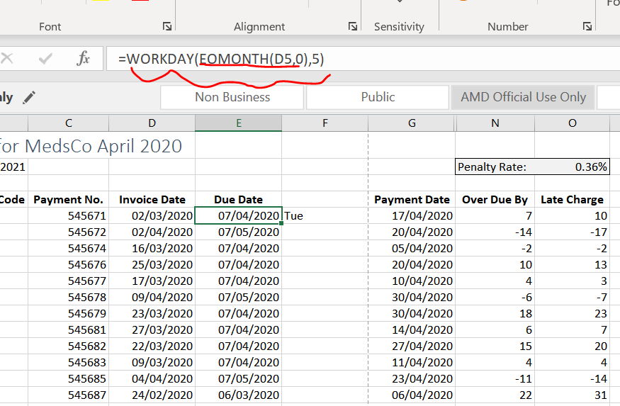
EOMONTH(date of last day of particular month)
Date of last day of this month
5 days after last day of this month

Slide 21
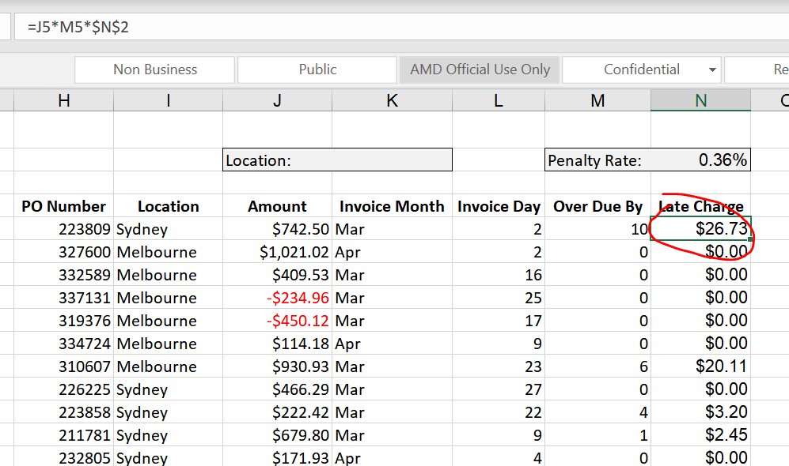
Absolute Referencing (A cell reference that always fixed )

Slide 22
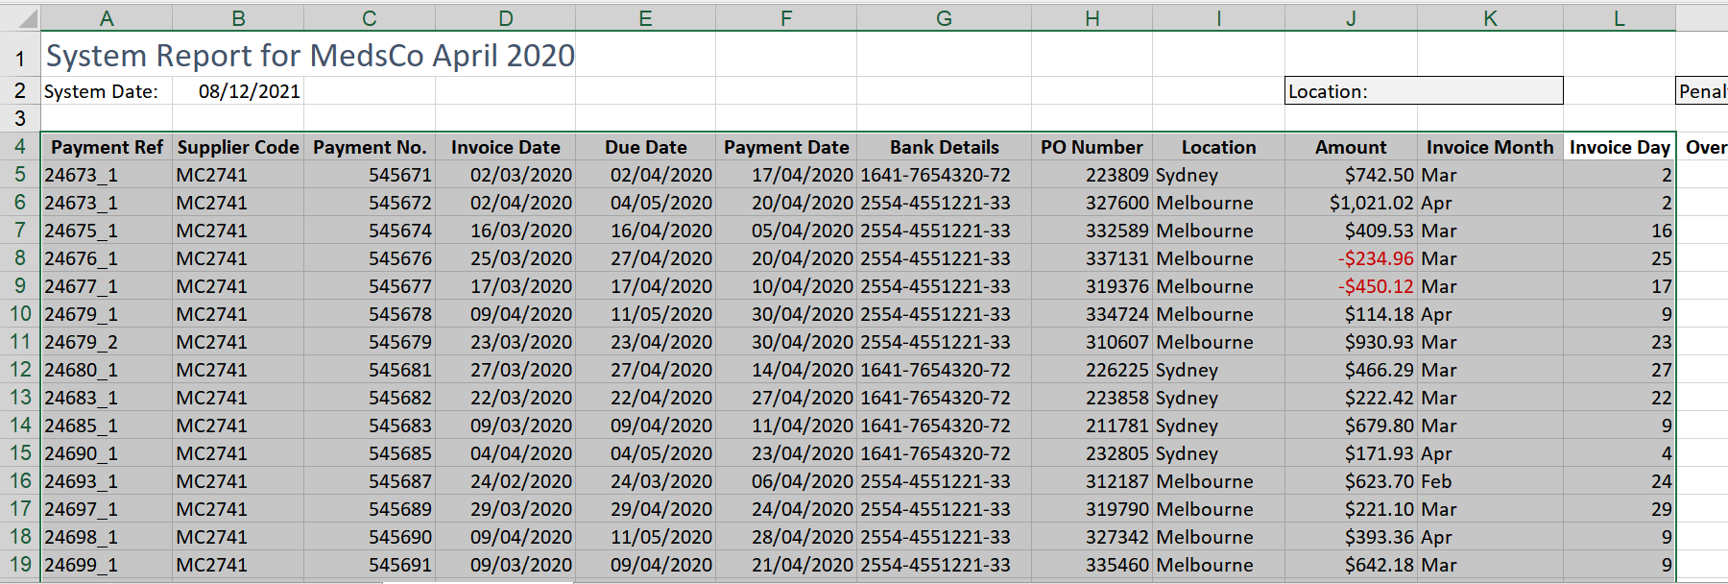
Create from selection (automatically create named ranges from the selected cells)
Select the whole range

Slide 23
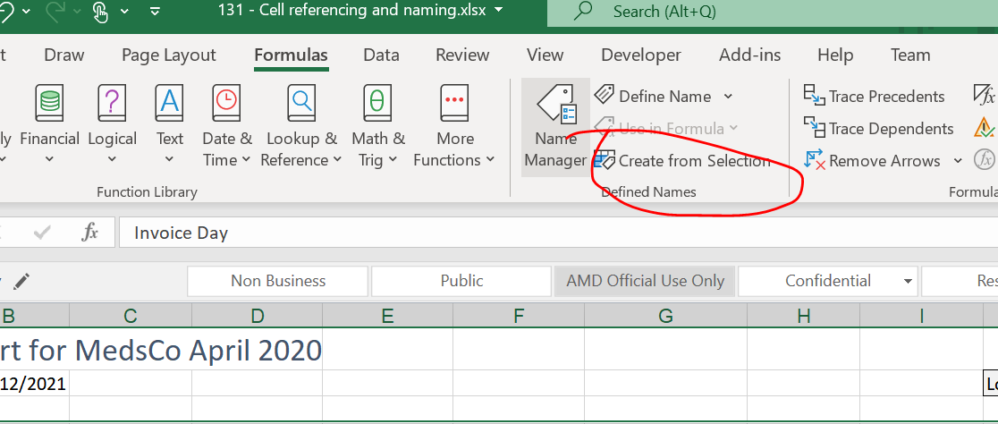
Cont…
Click “Create from Selextion” under Formulas

Slide 24
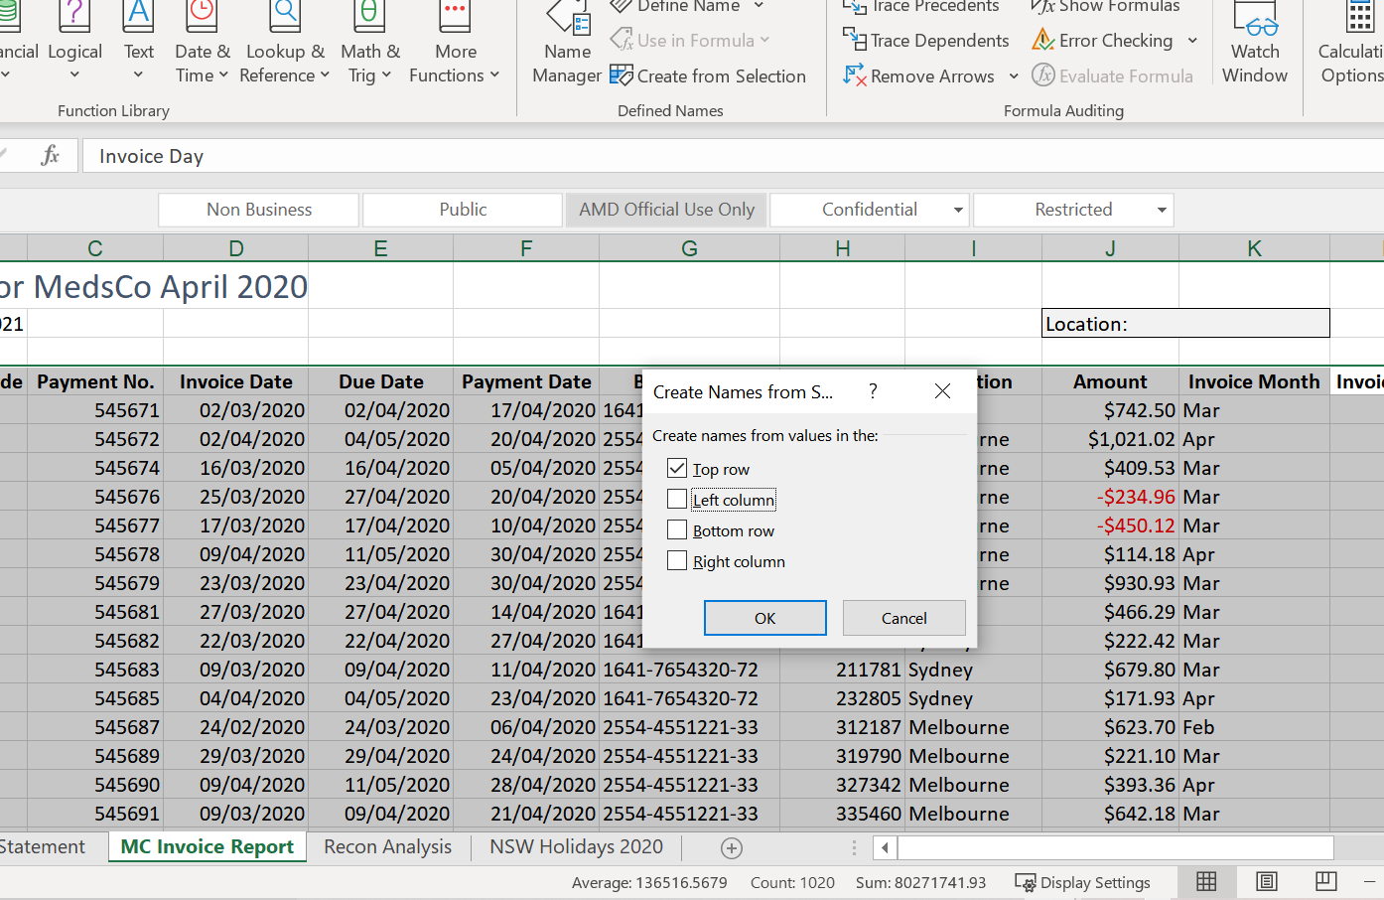
cont

Slide 25
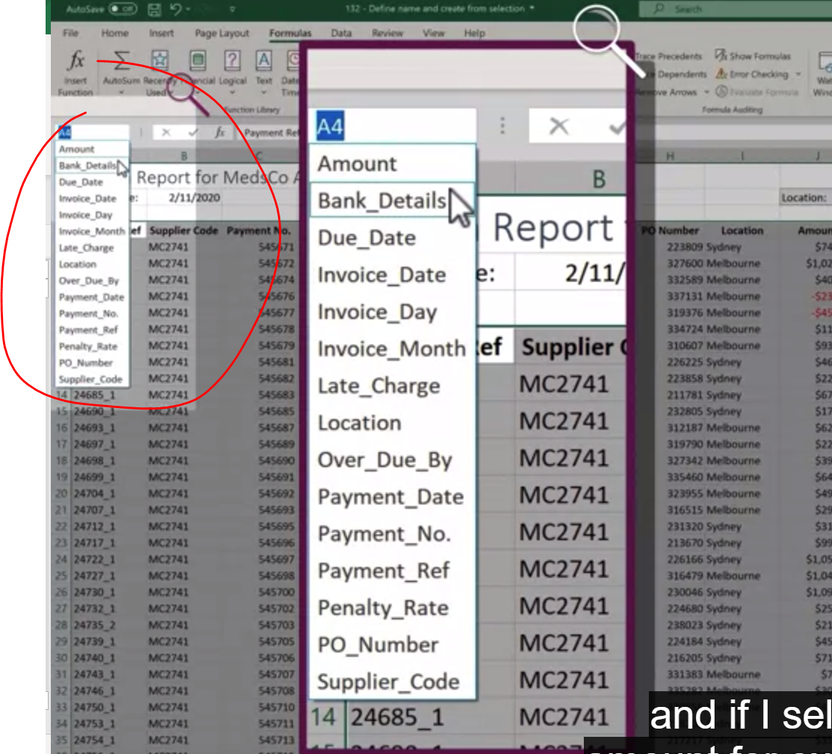
Cont..

Slide 26
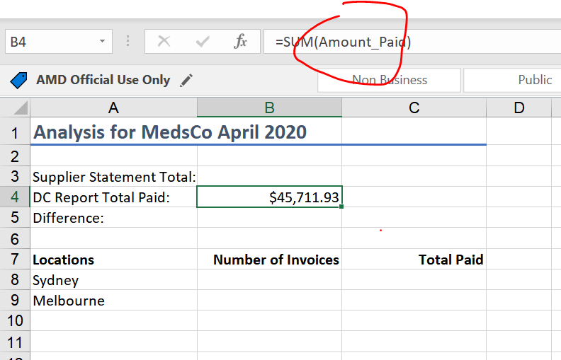
cont.
Name created in other worksheet

Slide 27
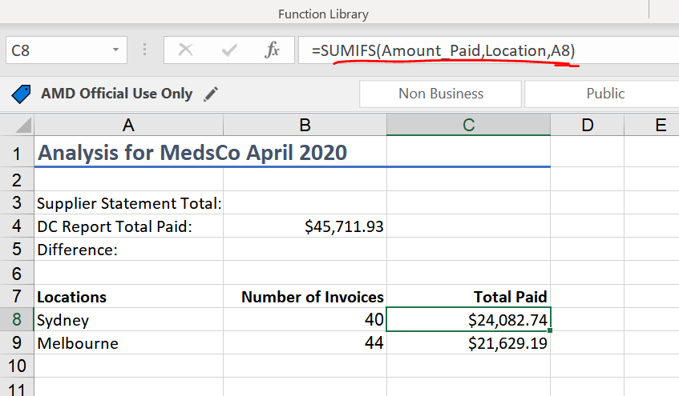
SUMIFS(Sums cells that match multiple criteria)
Sum for all the Sydney invoices

Slide 28
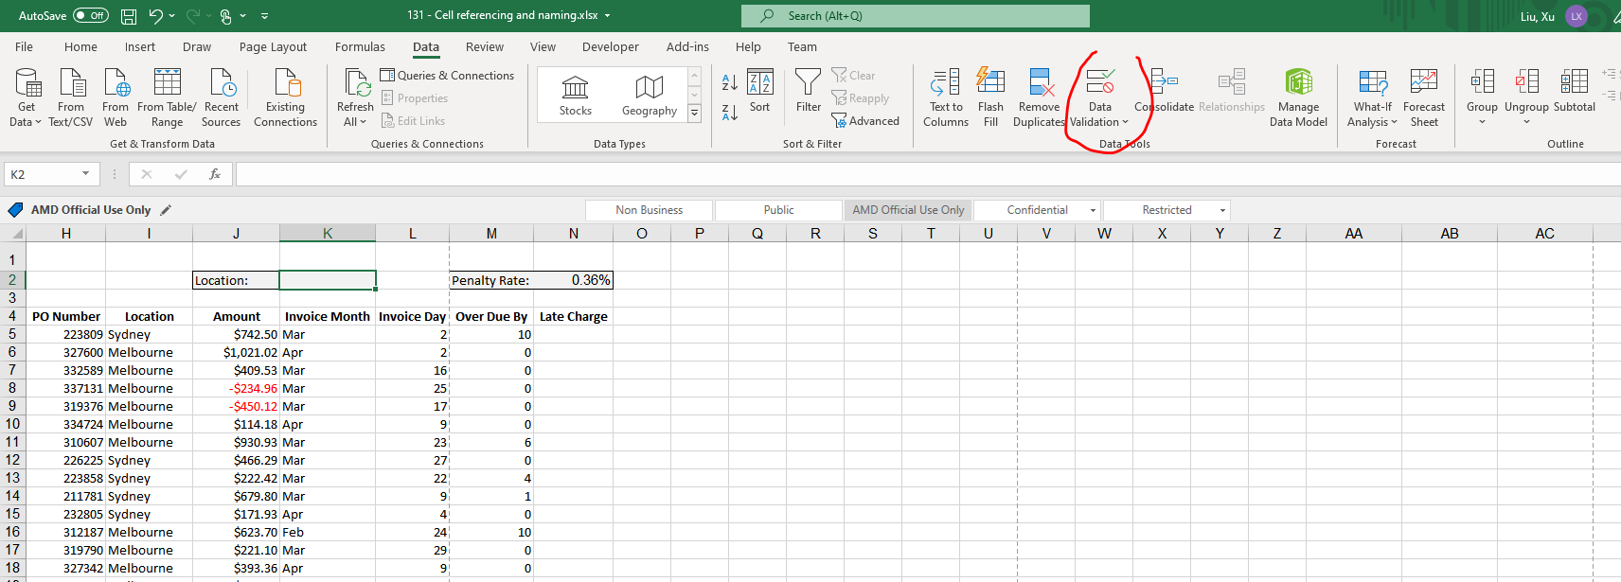
Data Validation (A feature designed to control what a user can enter into a cell)
It created a drop down list
Select cell and click “DATA”- > “DATA VALIDATION”

Slide 29
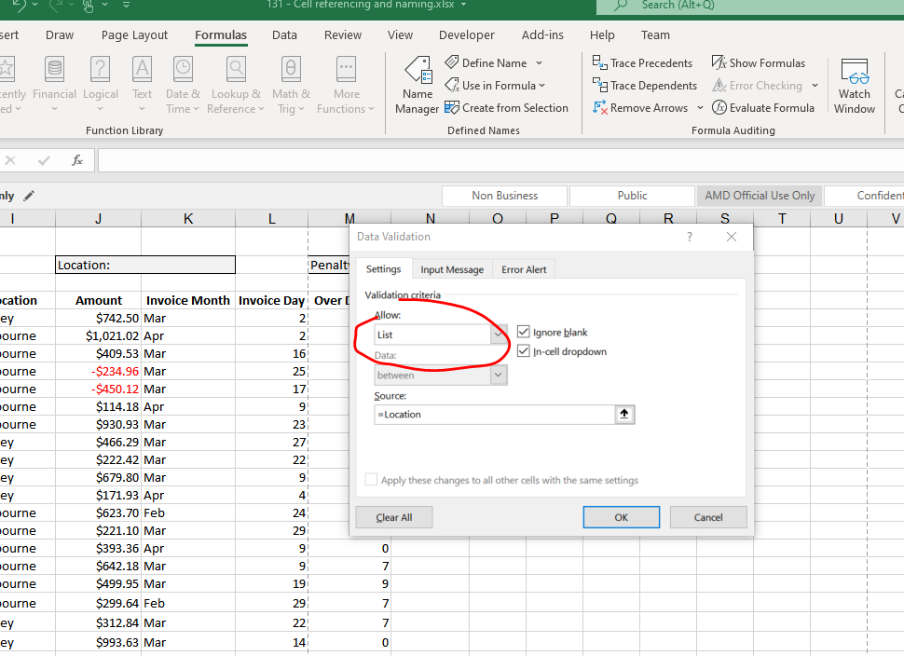
Cont..

Slide 30
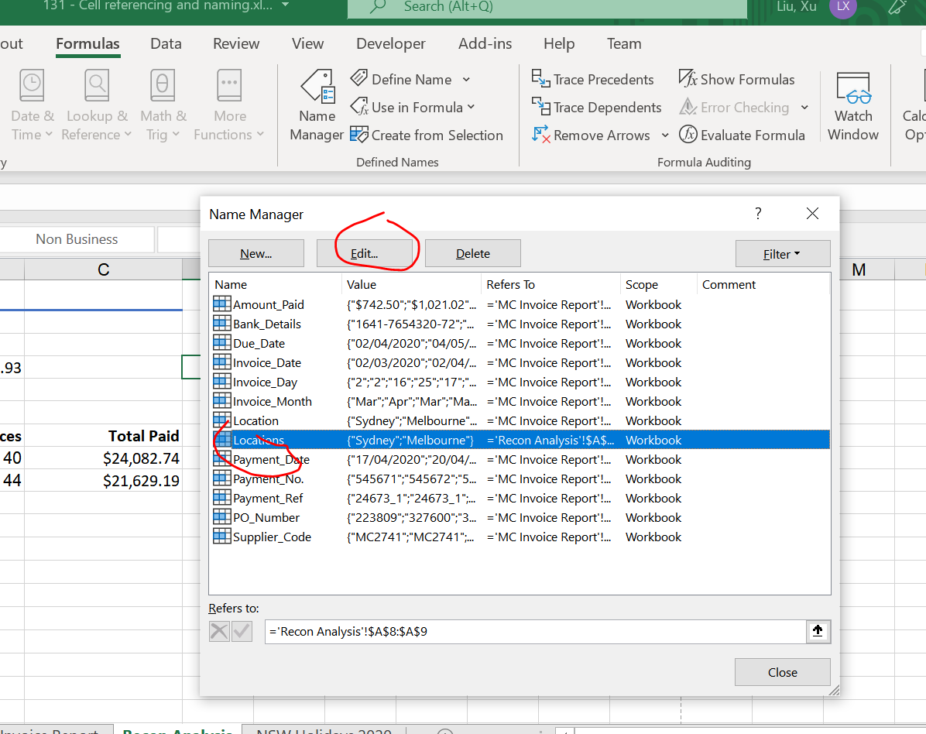
CONT

Slide 31
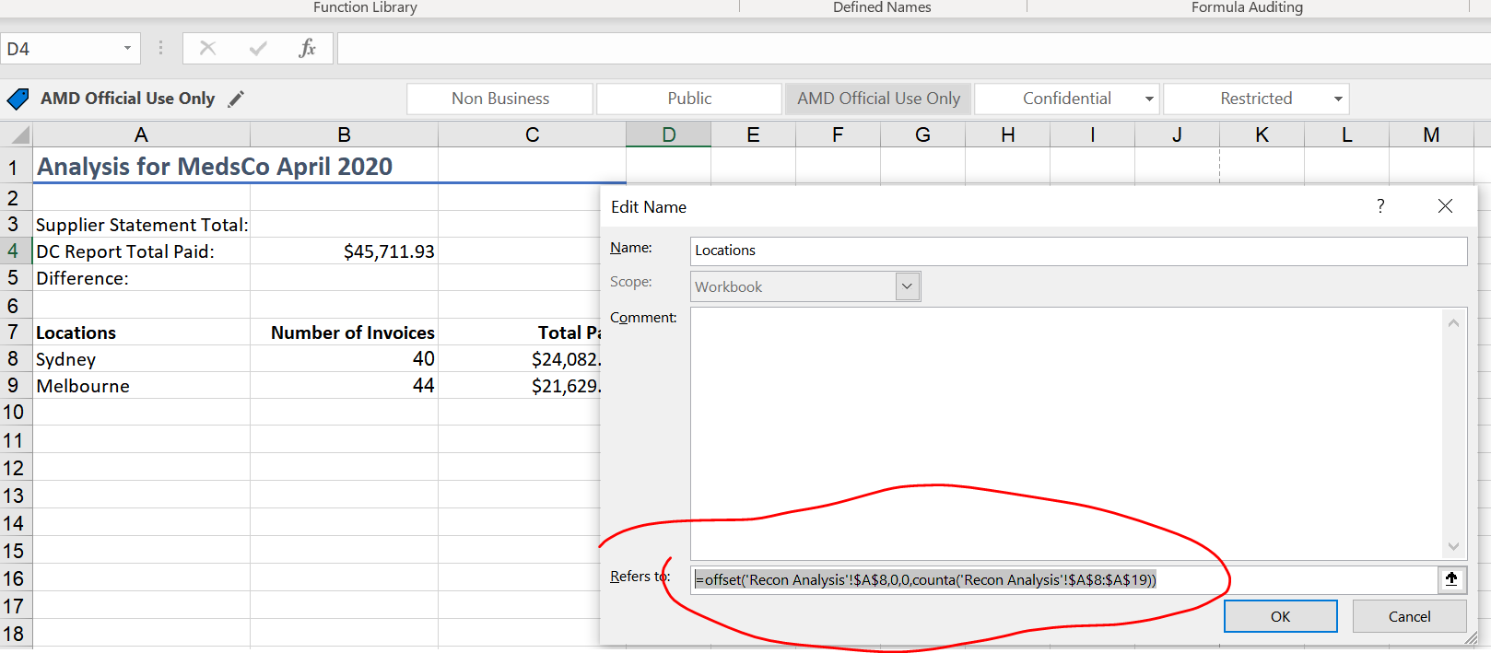
Edit the name locations (when we add new locations, the dropdown list will automatically updates)

Slide 32
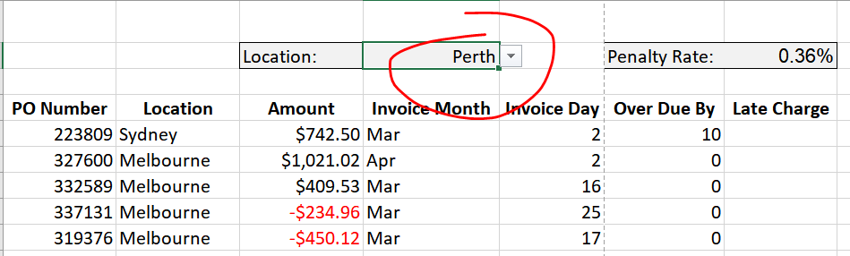
Dropdown list (base on locations)

Slide 33
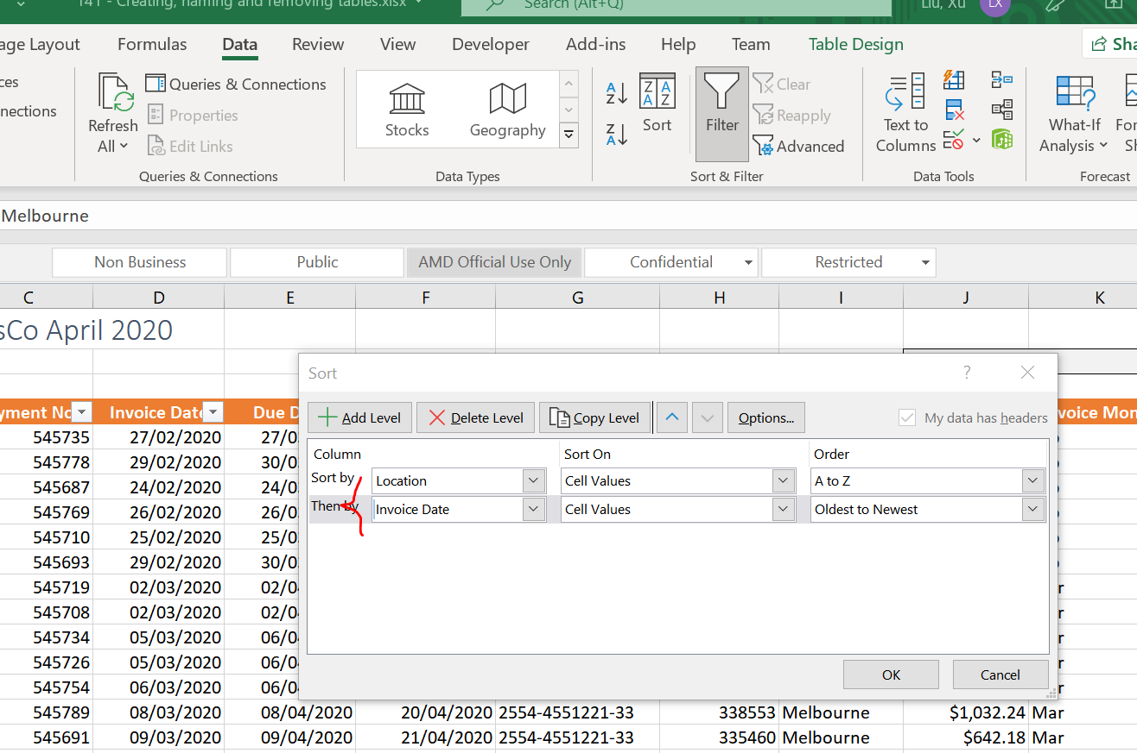
How to sort base on multiple criteria
Select “Data”-> “Sort”
Sort the table base on two criterias “location” & “invoice date”

Slide 34
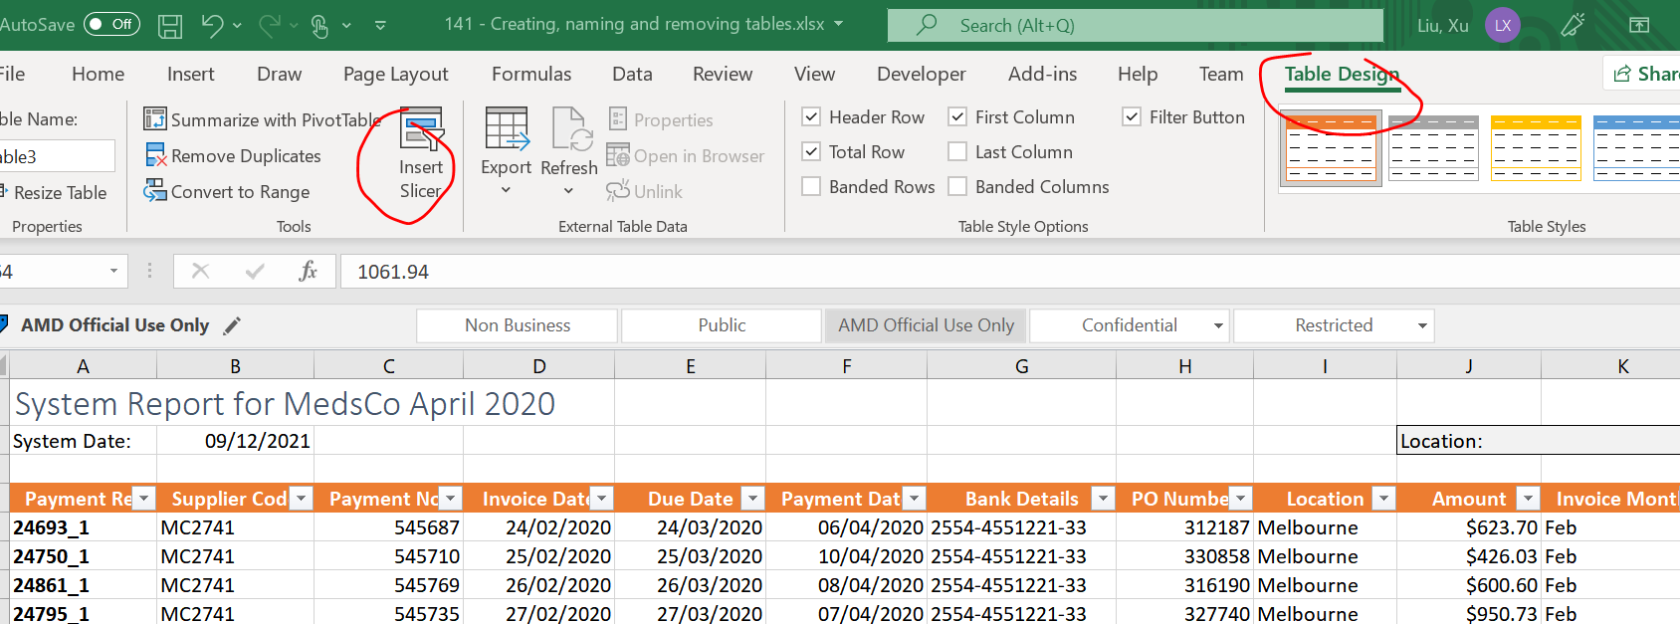
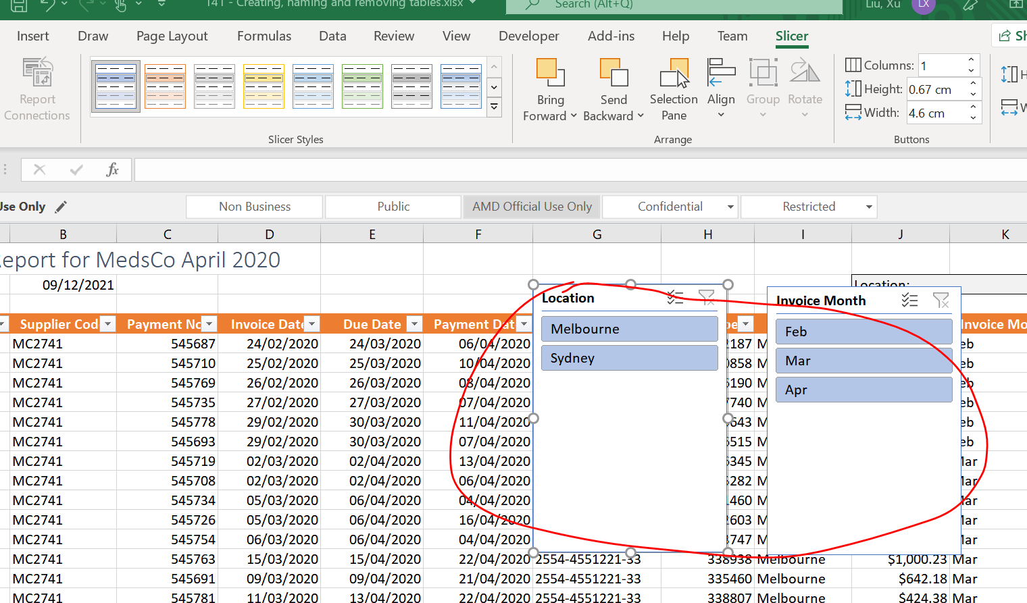
Slicer (visual element used to apply filters to tables)
Click “table design” and select “insert slicer”. 2 slicers been added

Slide 35
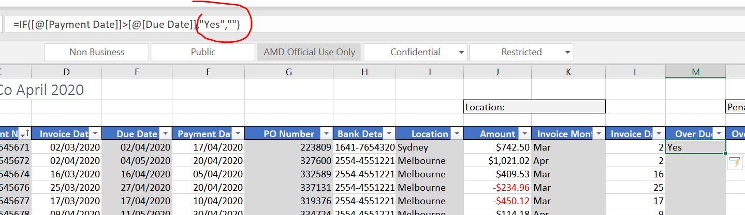
If
If date1 > date2, put a “Yes”. Otherwise, put empty

Slide 36
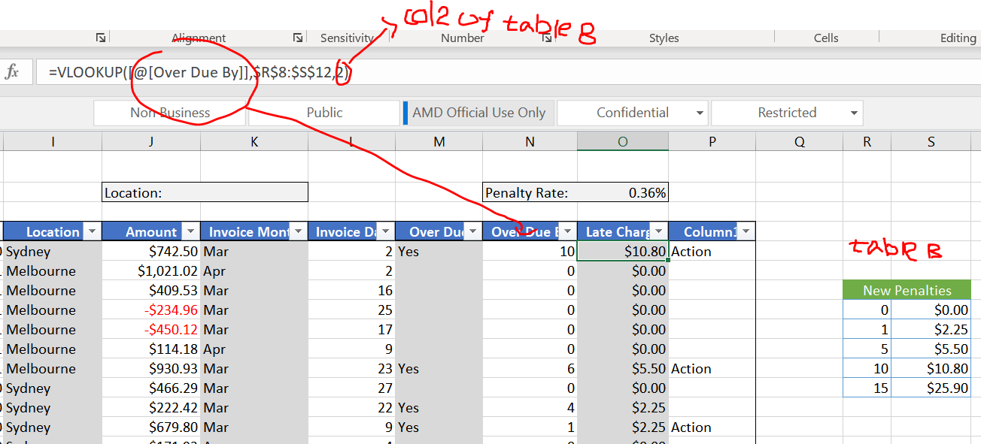
Vlookup (references a vertical table to find and return values)

Slide 37
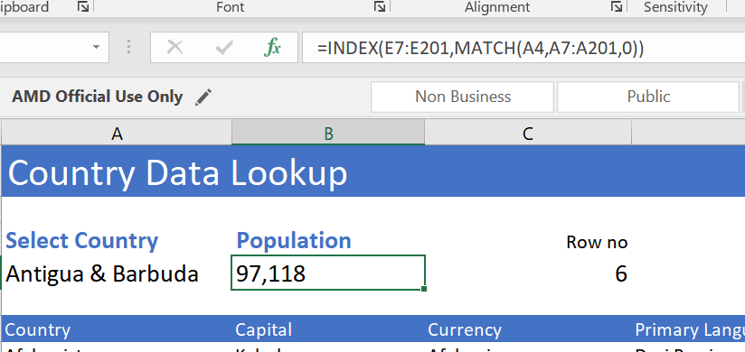
Match( locates the position of a lookup value in a row,column)
INDEX (returns a value in a list or table based on coordinate location)

